Slide 1
Diseases of the Urethra
Assistant Prof.
Dr. Firas Shakir
2019-2020

Slide 2
Anatomy
Male urethra is 20 cm long and is divided into prostatic , membranous ,bulbar and penile parts.
The female urethra is 4 cm long.
Blood supply comes from the internal pudendal arteries and venous drainage is into the internal pudendal veins.
Lymphatic drainage is to the internal and common iliac lymph nodes.

Slide 3
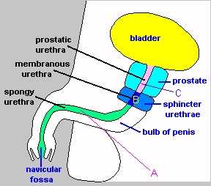

Slide 4
Disorders of the male urethra
Congenital disorders
Congenital urethral stricture.
Posterior urethral valves.
Anterior urethral valves.
Hypospadias.
Epispadias.

Slide 5
2. Posterior urethral valves
The most common obstructive condition in infants and newborns.
Children are present with varying degrees of urinary obstruction .
Voiding cystourethrography is the study of choice to establish the diagnosis .
The diagnosis is confirmed by visual observation of the valves .
The treatment should be individualized .

Slide 6
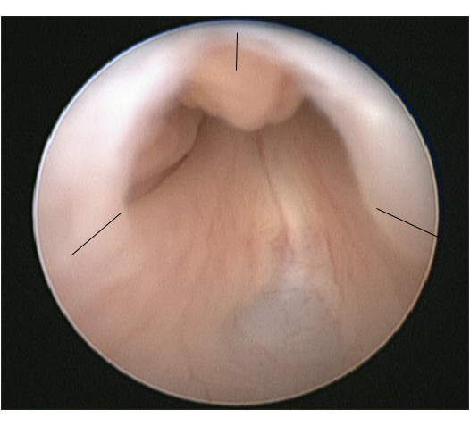

Slide 7
4. Hypospadias
The urethral meatus opens on the ventral side of the penis
Forms of hypospadias are classified according to location
Seventy percent of all cases are distal penile or coronal.
The main symptoms are difficulty in directing the urinary stream .
The principles of repair are:
- straightening of the penis .
- Reconstruction of neourethra .
- Advancement of the urethra .

Slide 8
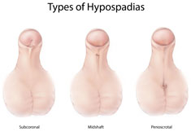
Hypospadias

